Slide 1


Crowdsourced Device Tracking: Security and Privacy Concerns
Assignment: Research Proposal Presentation
Student Number: 126853
Date: 9th May 2022

Slide 2
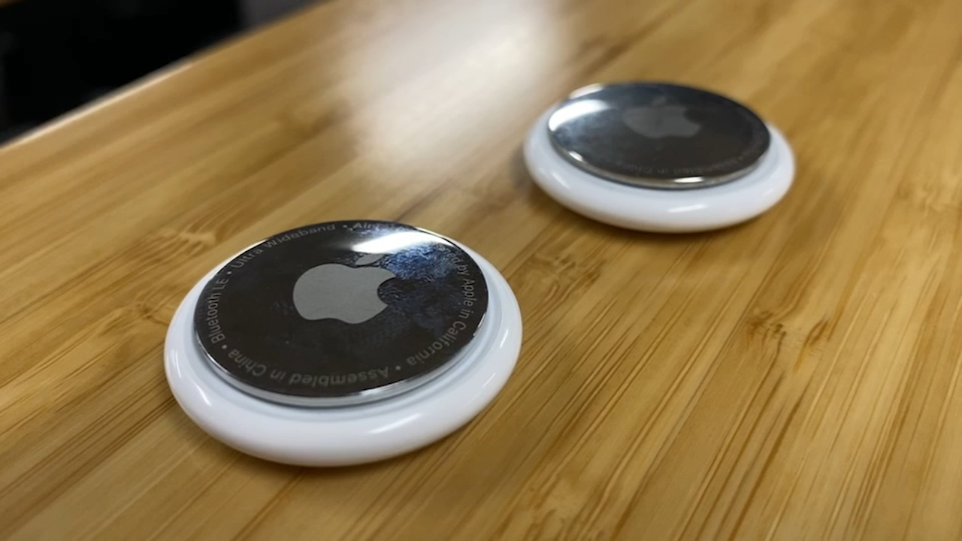
Significance/Contribution to discipline
The Internet of Things (IoT) is a fairly recent category of technology, where devices are internet connected, allowing remote control in most cases. Examples include Smart Assistants (Google Home), Smart Lighting (Phillips Hue) amongst many others.
My research aims to highlight the fundamental security flaws and risks behind using such technology, in particular, the usage within a crowdsourced tracking environment (Such as that used by Apple AirTags and Tile Mate trackers). The overall aim of this is to produce information that can inform the consumer decision to use the technology and make them aware of the risks.
Figure 1: Apple AirTag

Slide 3
Research Question
Research Question:
What action can be taken by IoT device manufacturers to ensure that security and privacy of their users can be sustained?

Slide 4
Aims and Objectives
Aim:
To investigate the effectiveness of crowdsourced tracking and related privacy concerns.
Objectives:
Produce a series of datasets demonstrating the accuracy of crowdsourced tracking in an urbanised environment.
Develop of a tool to explain the data and risks behind IoT tracking devices in a jargon-free manner for consumers.

Slide 5
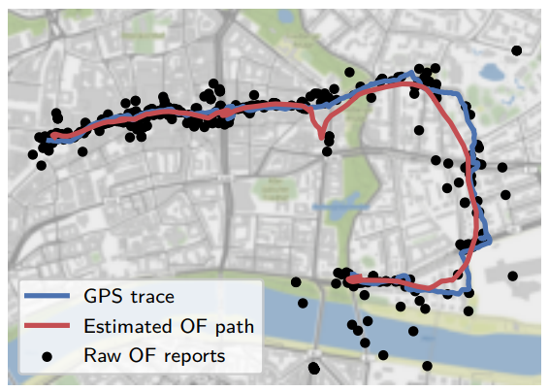
Key Literature (Secure Mobile Networking Lab)
The researchers at the Secure Mobile Networking lab (Heinrich et al., 2021) found the following as part of their research:
During a 3.3km walk, lasting 55 minutes, their device triggered a total of 489 reports.
During this walk, the crowdsourced reports had an estimated 25.9m deviation from the GPS trace path.
Reports became more inaccurate when travelling at faster speeds.
Figure 2: Smoothed crowdsourced reports correlated with GPS trace (Heinrich et al., 2021)

Slide 6
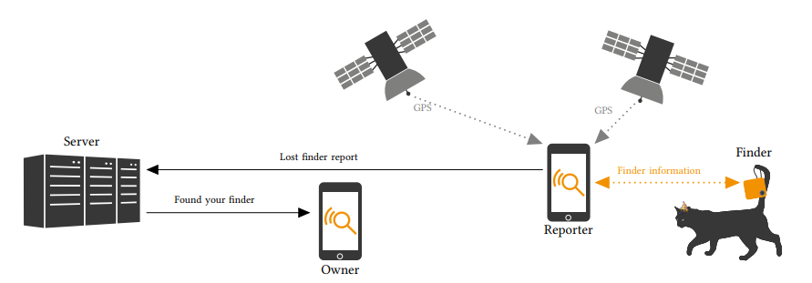
Key Literature (Secure Mobile Networking Lab - Conference)
During this piece of research undertaken by the Secure Mobile Networking Lab (Weller et al., 2020), they identified the following issues with existing trackers:
Tile servers could be manipulated to force any connected device to ‘ring’ providing they were able to source/guess the UUID.
Attackers could subscribe to a Topic, which provided them with a User UUID, Client UUID and Tile Device UUID.
Trackers produced by Nut could generate a ‘Share Link’, which exposed user information as well as location reports of linked devices.
Figure 3: PrivateFind protocol ecosystem overview (Weller et al., 2020)

Slide 7
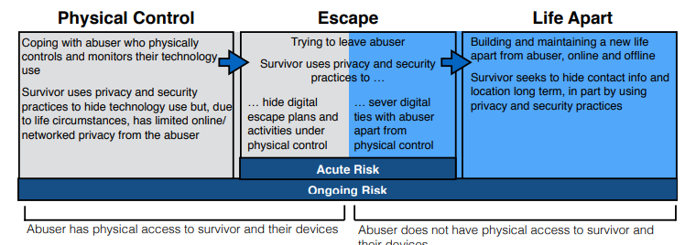
Key Literature (University College London)
Researchers from the University College London (Parkin et al., 2019) established that almost all forms of IoT could facilitate tech-abuse.
A few examples include:
Wearable Devices – Could allow abusers to monitor abusers.
Smart Security – Could remotely provide access to doors to abusers.
Laptops and Tablets – The ability to monitor and change linked device settings.
Figure 4: Phases of technology-facilitated abuse (Parkin et al., 2019)

Slide 8
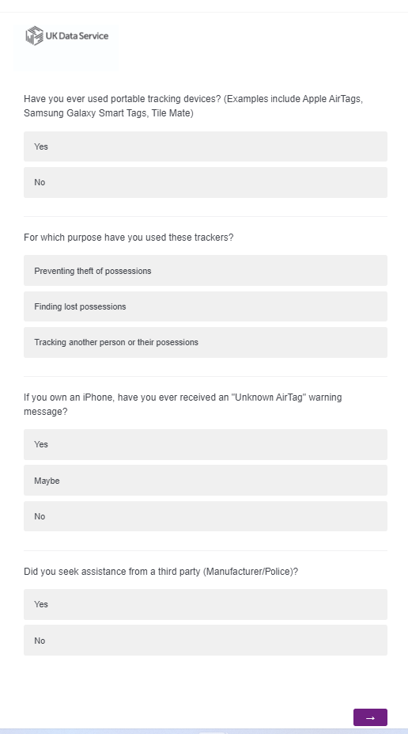
Methodology
The majority of my data will be sourced in a Quantitative method using a questionnaire, which will be distributed to a series of potential participants. Some information I aim to gather has been listed below:
Age of participants.
Whether they are aware that small devices can be used to track them without their knowledge.
Whether they have received a warning about an “Unknown AirTag”
If they have used the trackers, what their main intention was.
Figure 5: Example questionnaire presented within the Qualtrics survey platform.

Slide 9
Ethical Considerations
As my research is primarily focused around the tracking of individuals and possessions using crowdsourced data, it is inevitable that some survey participants may have had these techniques used on themselves for nefarious purposes. For that reason, I will need to ensure that data is collected in a non-identifiable fashion to protect the identity of the participants.
To supplement this information, I intend to collect aggregated statistics from major police forces in the UK through Freedom of Information requests (As well as information published in the public domain) to get an idea of the number of criminal cases where the use of crowdsourced tracking have been used.

Slide 10
Risk Assessment
Identified Risks | Likelihood | Potential Impact/Outcome | Risk Management/Mitigating Factors
Survey participant disclosing information that is related to criminal behaviour that they may have undertaken (Legal) | Low | Information would need to be passed on to relevant authorities. | All data collected will be of quantitative fashion, preventing the usage of free-text fields. At the front of the questionnaire, contact details of relevant authorities will be listed.
Survey participant disclosing that they have been a victim of abuse or exploitation using the discussed technology (Safeguarding) | Medium | Information would need to be passed on to relevant authorities. | All data collected will be of quantitative fashion, preventing the usage of free-text fields. At the front of the questionnaire, contact details of relevant authorities will be listed.
Figure 6: Research risk assessment. Adapted from a template produced by Brunel University London (n.d.)

Slide 11
Description of Artefacts
Within this research project, I aim to produce the following artefacts:
Datasets – The production of datasets to demonstrate the overall effectiveness of using crowdsourced information for tracking individuals. This may include the accuracy of identifying the locations of both moving targets, as well as static items representing lost possessions.
Informative Tools – The production of an informative tool informing consumers of the risks of such technology and the information which is readily available online.

Slide 12
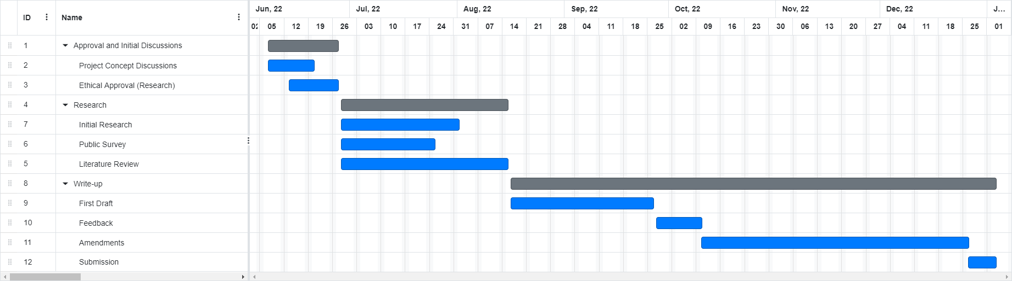
Timeline
I have identified a series of tasks that will need to be undertaken in order to make this research project successful.
Based upon a start date of the 7th of June and an overall duration of 30 weeks, I have produced the Gantt chart below.
Figure 6: Gantt Chart demonstrating proposed tasks and durations.

Slide 13
References
Brunel University London. (n.d.) Research Ethics Risk Assessment and Management – Example. Available from: https://www.brunel.ac.uk/about/documents/pdf/Risk-template-example.pdf [Accessed 16th May 2022].
Heinrich, A., Stute, M., Kornhuber, T., Hollick, M. (2021) Who Can Find My Devices? Security and Privacy of Apple’s Crowd-Sourced Bluetooth Location Tracking System: Proceedings on Privacy Enhancing Technologies. 1-19. DOI: https://doi.org/10.48550/arXiv.2103.02282
Parkin, S., Patel, T., Lopez-Neira, I., Tanczer, L. ‘Usability Analysis of Shared Device Ecosystem Security:Informing Support for Survivors of IoT-Facilitated Tech-Abuse’, NPSW. Costa Rica, 2019. San Carlos: Association for Computing Machinery. 1-15.
Weller, M., Classen, J., Ullrich, F., Waßmann, D., Tews, E. (2020) ‘Lost and Found: Stopping Bluetooth Finders from Leaking Private Information’, WiSec. Austria, 2020. Linz: Association for Computing Machinery. 184-194.

